Slide 1
Secure Sockets Layer (SSL) Protocol
by Steven Giovenco

Slide 2
Overview
History
SSL
SSL Roles
Protocol Stack
The 4 Protocols
The Record Layer
Message Authentication Code
Handshaking
Handshaking
ChangeCipherSpec Protocol
More Handshaking
Alert and Application Protocols
Benefits and Drawbacks

Slide 3
History
Need for secure web communication
Netscape
  Worried especially about credit card transaction over the web
  Also worried about ease of implementation since they wanted this to be industry-standard, not proprietary
  SSLv1 - 1994

Slide 4
SSLv2
SSLv2 also released in 1994
  SSLv1 wasn’t widely implemented
Rules for establishing secure connection
Rules for public key encryption
Optional certificate-based authentication for servers and even clients
Flexible
  No specifically required encryption, compression, or key generation algorithm

Slide 5
SSL Roles
Two roles
  Client
    Initiates communication, lists possibilities for choices
  Server
    Listens for client connections, chooses from possibilities sent from clients
Both roles simply add Secure Sockets Layer to protocol stack

Slide 6
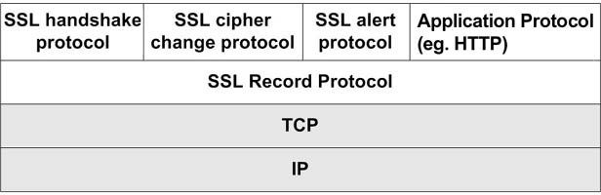
SSL and the Protocol Stack
SSL between Transmission Control Protocol (TCP) layer and Application layer
Actually 2 layers
  Record
  Secure Application
Can run under any protocol that relies on TCP, including HTTP, LDAP, POP3, FTP

Slide 7
The Four Upper Layer Protocols
Handshaking Protocol
  Establish communication variables
ChangeCipherSpec Protocol
  Alert to a change in communication variables
Alert Protocol
  Messages important to SSL connections
Application Encryption Protocol
  Encrypt/Decrypt application data

Slide 8
Record Layer
Frames and encrypts upper level data into one protocol for transport through TCP
5 byte frame
  1st byte protocol indicator
  2nd byte is major version of SSL
  3rd byte is minor version of SSL
  Last two bytes indicate length of data inside frame, up to 2¹⁴
Message Authentication Code (MAC)

Slide 9
Message Authentication Code
MAC secures connection in two ways
  Ensure Client and Server are using same encryption and compression methods
  Ensure messages sent were received without error or interference
Both sides compute MACs to match them
No match = error or attack

Slide 10
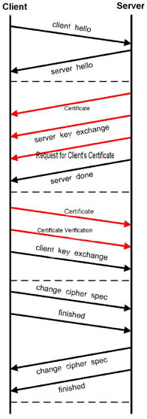
Handshaking Messages
ClientHello
ServerHello
*Certificate
ServerKeyExchange
*CertificateRequest
ServerHelloDone
*Certificate
*CertificateVerify
ClientKeyExchange
ChangeCipherSpec
Finished
*=optional

Slide 11
The Process Begins
Client Sends ClientHello
  Highest SSL version supported
  32-byte random number
  SessionID
  List of supported encryption methods
  List of supported compression methods

Slide 12
The Server Responds
Server Sends ServerHello
  SSL version that will be used
  32-byte random number
  SessionID
  Encryption method that will be used
  Compression method that will be used

Slide 13
Server Authentication
To authenticate Server, Server sends Certificate
  Server’s public key certificate
  Issuing authority’s root certificate
When Client receives Certificate, it decides whether or not to trust Server
  This is the only step that might involve User if User never specified whether or not to trust issuing authority before

Slide 14
Still Shaking Hands
Server Sends ServerKeyExchange
  Any information necessary for public key encryption system
If Sever wishes Client to be authenticated, Server sends CertificateRequest message
  The client would respond to this with a Certificate message encrypted with Server’s public key
Server sends ServerHelloDone

Slide 15
Client Responds
Client sends ClientKeyExchange
  Information necessary for public key encryption system
  Encrypted with Server’s public key
Compute secret keys using Key Derivation Function such as Diffie-Hellman
If Client is being authenticated, Client sends CertificateVerify
  Digest of previous messages encrypted with Client’s private key

Slide 16
ChangeCipherSpec Protocol
Special protocol with only one message
When Client processes encryption information, it sends ChangeCipherSpec message
  Signals all following messages will be encrypted
ChangeCipherSpec is always followed by Finished message

Slide 17
The End of the Beginning
Upon receipt of ChangeCipherSpec, Server sends its own ChangeCipherSpec and Finished messages
After both Client and Server receive Finish messages, Handshaking phase is over
All following communication is encrypted
Encryption and compression methods can be changed with new ChangeCipherSpec messages

Slide 18
Alert and Application Protocols
Alert protocol always two byte message
  First byte indicates severity of message
    Warning or Fatal
    A Fatal alert will terminate the connection
  Second byte indicate preset error code
  Secure connection end alert not always used
Application Protocol is HTTP, POP3, SMTP, or whatever application is being used
  Simply give a datagram to the Record Layer

Slide 19
Benefits
Ease of implementation
  For network application developers
    As easy as implementing unsecured Sockets
  For network implementation developers
    Simply add layer to established network protocol stack
  For Users
    Only need to authorize certificates

Slide 20
Drawbacks
More bandwidth needed
Slower
Needs a dedicated port – 443 for HTTPS
Assumes reliable transport for underlying transport protocol
  No UDP
  Implications for streaming media, VoIP

Slide 21
Summary
Need for secure communication
Netscape issues SSL spec
The 4 SSL protocols
Message Authentication Code
Handshaking
Alert and Application messages
Benefits and Drawbacks

Slide 22
References
Rescorla, Eric. SSL and TLS. Boston: Addison-Wesley, 2001
“Secure Sockets Layer.” Netscape Network. 2004. Netscape Communications Corporation. 2 Nov 2004 <http://wp.netscape.com/security/techbriefs/ssl.html>
“Secure Socket Layer.” WindowSecurity.com. 22 July 2004. WindowSecurity.com. 2 Nov 2004 <http://www.windowsecurity.com/articles/
Secure_Socket_Layer.html>
Thomas, Stephen A. SSL and TLS Essentials. New York: Wiley Computer
Publishing, 2000
“Transport Layer Security.” Wikipedia the Free Encyclopedia. 1 Nov 2004. Wikipedia. 2 Nov 2004 <http://en.wikipedia.org/wiki/Transport_Layer_Security>

